Slide 1
Lipedema 2021
Reports of interest and BMI
Thomas Wright; MD, FAVLS

Slide 2
Lipedema reduction surgery in the US
Quality of life improved in 84% and pain improved in 86% of patients. Ambulation improved most in lipedema Stage 3 (96%). Weight loss occurred in all stages by 3 months after surgery. Complications included growth of loose connective tissue within and outside treated areas, tissue fibrosis, anemia, blood clots, and lymphedema
Lipedema reduction surgery is a standard method of improving the lives of patients with lipedema in Germany and is now being performed in the USA.
There are no data on the benefits of lipedema reduction surgery in the USA. This article presents self-reported data by women with lipedema who have undergone lipedema reduction surgery in the USA, with a focus on pain and quality of life that have been followed long-term in studies out of Germany.
Pant and dress size reduction is on average 3 and 2 sizes decreased

Slide 3
Positive and Negative of Lipedema Reduction surgery in US
Outcomes
Positive | Negative
Improvement in energy level or fatigue | Fat returning or increasing after treatment, including lipomas in treated and untreated areas
Improvement in joint/arthritic pain | Fibrosis
Improved mobility | Asymmetrical body proportions
Decreased pain levels | Numbness in treated area
Improved self-esteem and body image | Recovery interfered with daily life longer than expected

Slide 4
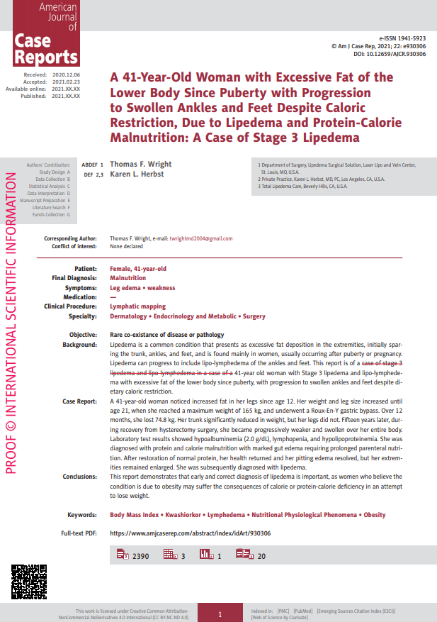

Slide 5
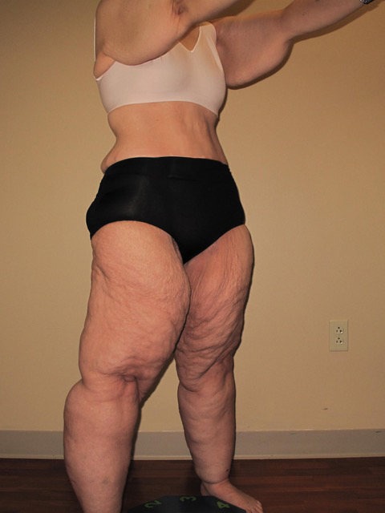
Lipedema and Malnutrition

Slide 6
Lipedema and Malnutrition
A 41-year-old woman noticed increased fat in her legs since age 12 max weight of 165 kg, a Roux-En-Y gastric bypass.
Over 12 months, she lost 74.8 kg. Her trunk significantly reduced in weight, but her legs did not. She was instructed to lose additional weight.
15 years later, S/P HSX, weak and diffuse swelling -Alb (2.0 g/dL),
Dx protein and calorie malnutrition with gut edema requiring TPN
subsequent Dx lipedema.

Slide 7
Conclusions
This report demonstrates that early and correct diagnosis of lipedema is important, as women who believe the condition is due to obesity may suffer the consequences of calorie or protein-calorie deficiency in an attempt to lose weight.

Slide 8
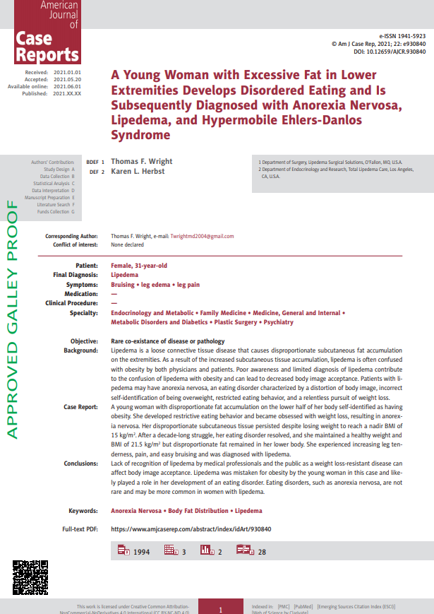

Slide 9
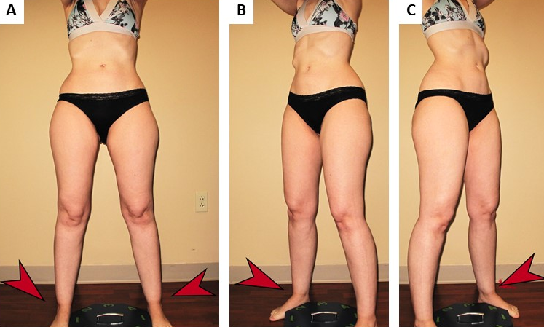
Lipedema and Anorexia

Slide 10
Lipedema and Anorexia
A young woman with disproportionate fat accumulation on the lower half of her body self-identified as having obesity. She developed restrictive eating behavior and became obsessed with weight loss, resulting in anorexia nervosa. Her disproportionate subcutaneous tissue persisted despite losing weight to reach a nadir BMI of 15 kg/m2 .
After a decade-long struggle, her eating disorder resolved, and she maintained a healthy weight and BMI of 21.5 kg/m2 but disproportionate fat remained in her lower body.
She experienced increasing leg tenderness, pain, and easy bruising and was diagnosed with lipedema.

Slide 11
Conclusions
Lipedema is poorly recognized by medical professionals and the public. This can affect body image acceptance. Lipedema was mistaken for obesity by the young woman in this case and likely played a role in her development of an eating disorder. Eating disorders, such as anorexia nervosa, are not rare and may be more common in women with lipedema.

Slide 12
Lipedema and BMI

Slide 13
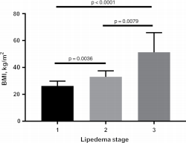
Stage 1 has BMI usually around 25; Stage 2 has BMI often in 35;
Stage 3 often has BMI greater than 40

Slide 14
What Is BMI and Why Is It an Inaccurate and Potentially Misleading Description of Lipedema and Other Diseases?
Body Mass Index (BMI) Kg/ m2 = is not a biological representation of a person’s overall health.
Lambert Adolphe Jacques Quetelet, a Belgian mathematician, created the BMI formula as a way to quickly and easily estimate what percentage of the overall population might be obese or at risk for starvation.
Obesity is defined by the World Health Organization (WHO) as having a BMI at or above 30 kg/m².³

Slide 15
Body Mass Index (BMI)
Increased by increased muscle mass - muscle mass has a higher density than fat and therefore, has a larger impact on BMI.
Lipedema causes higher BMI, but this will not correlate with higher cardiovascular or diabetes risks.

Slide 16
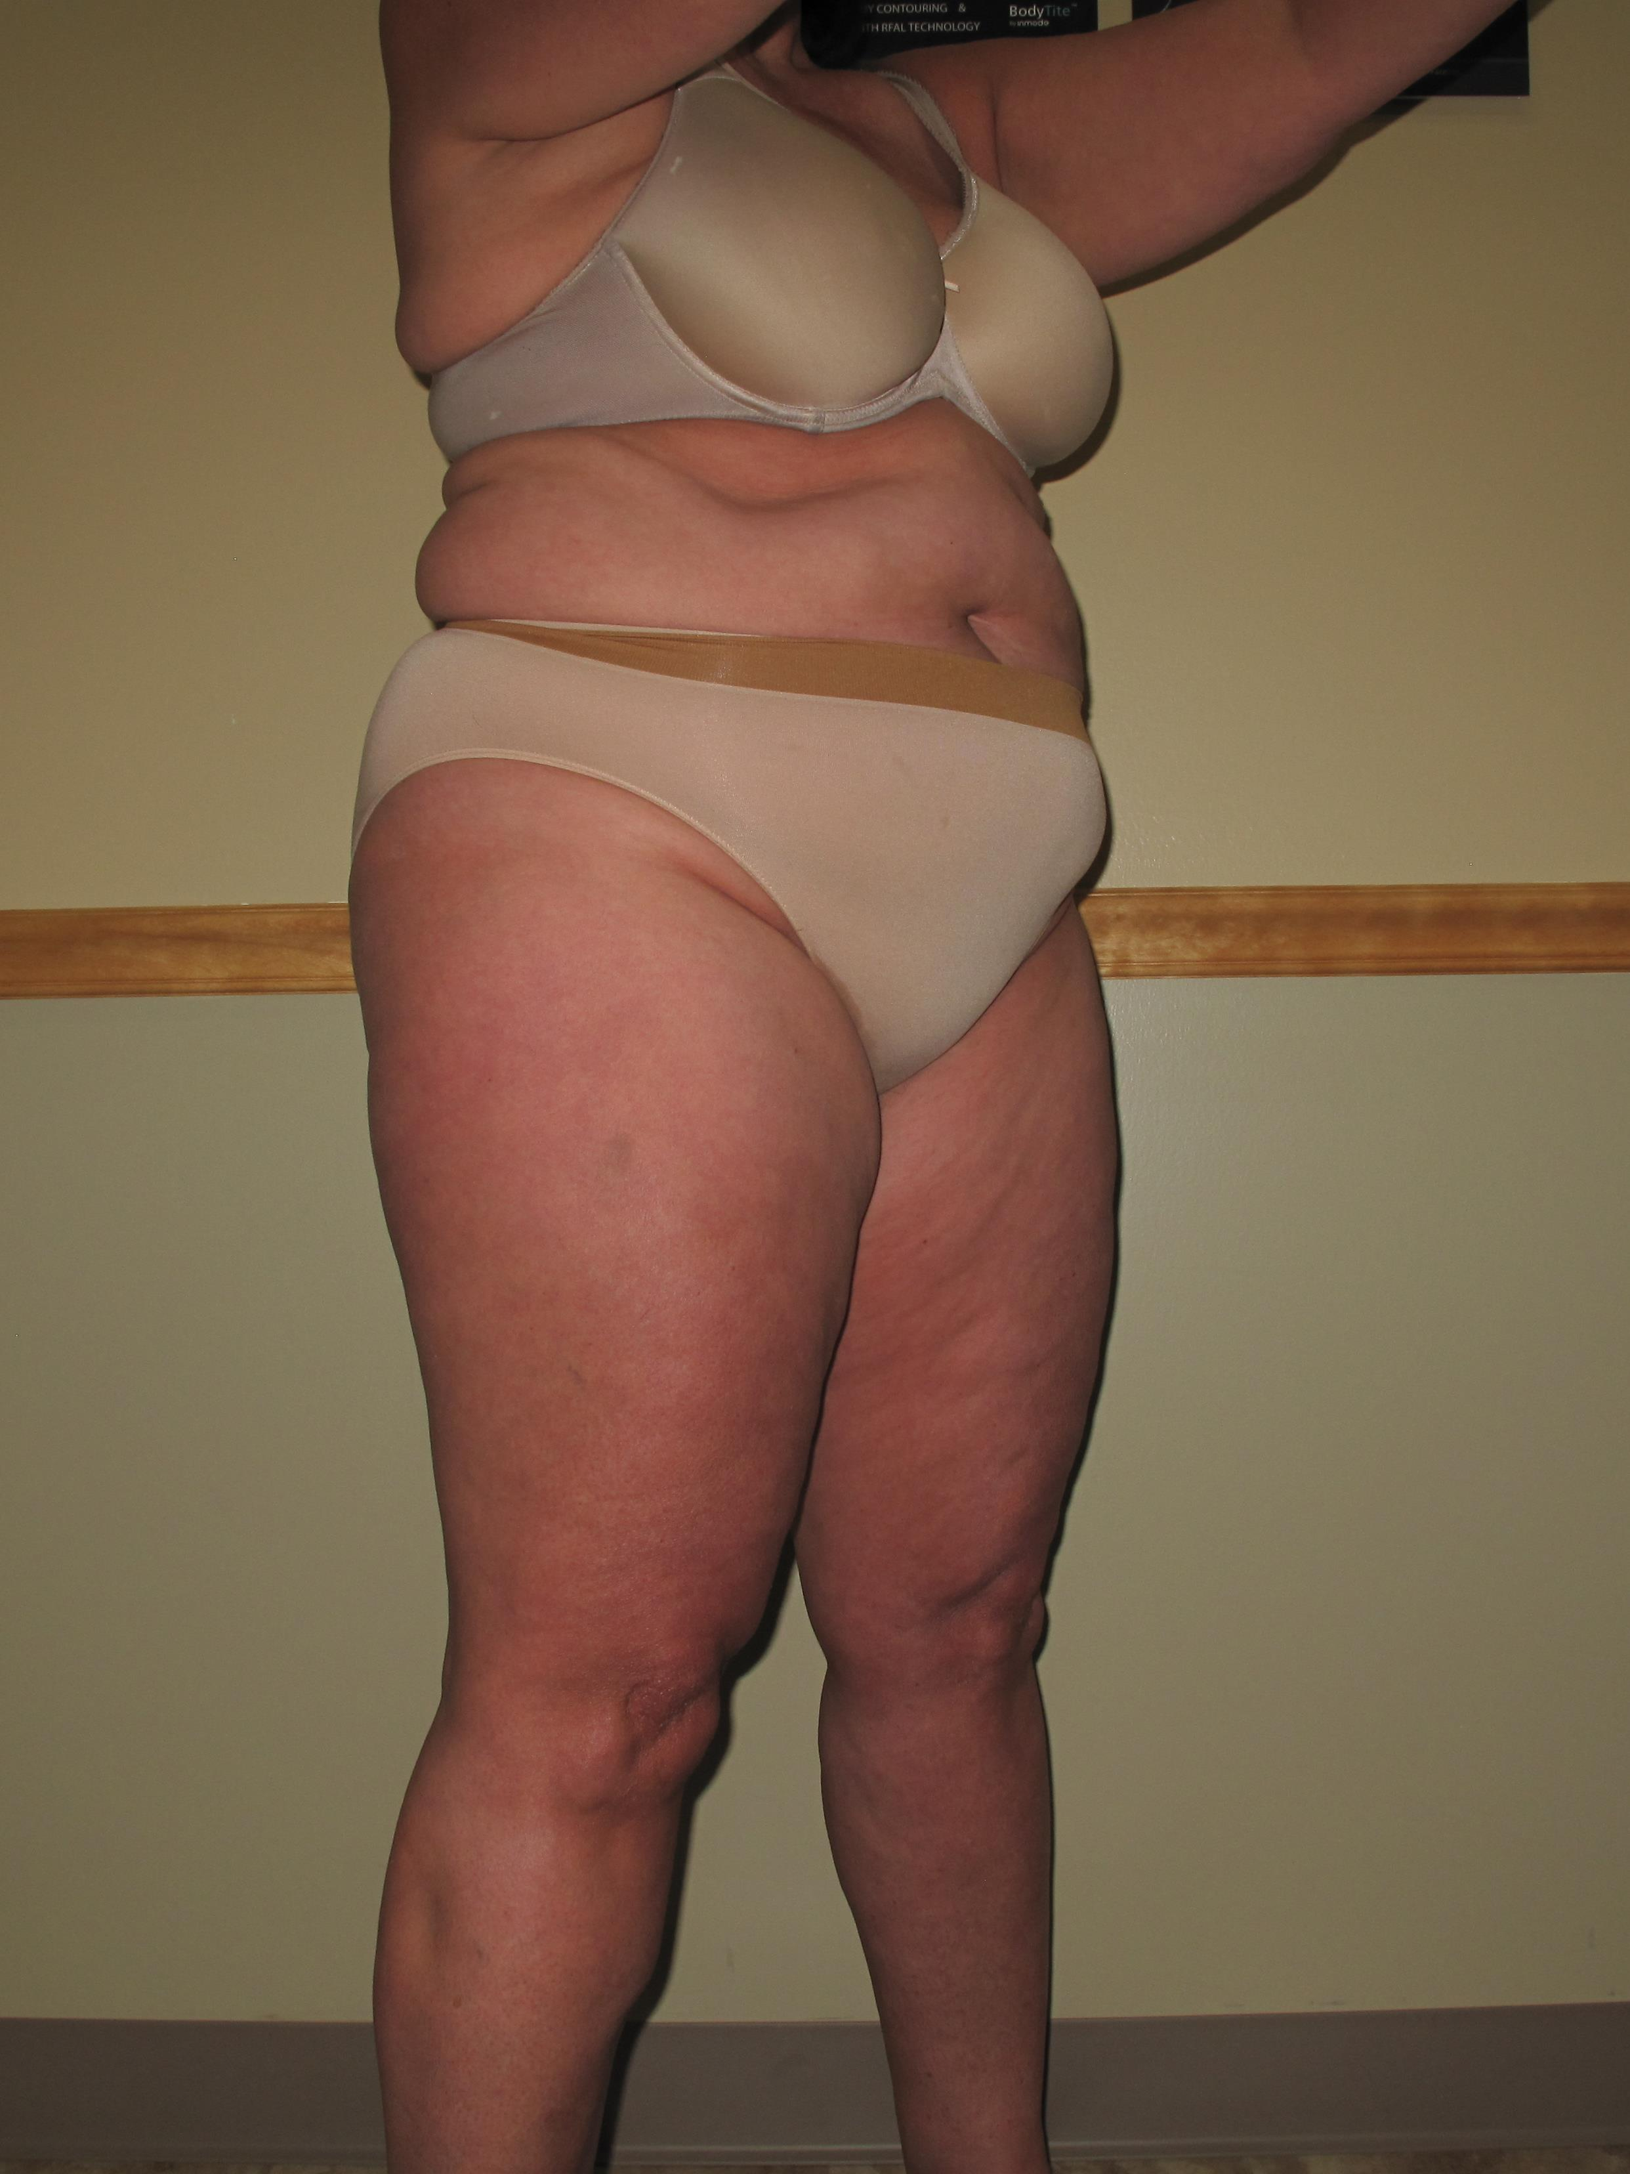
Obesity

Slide 17
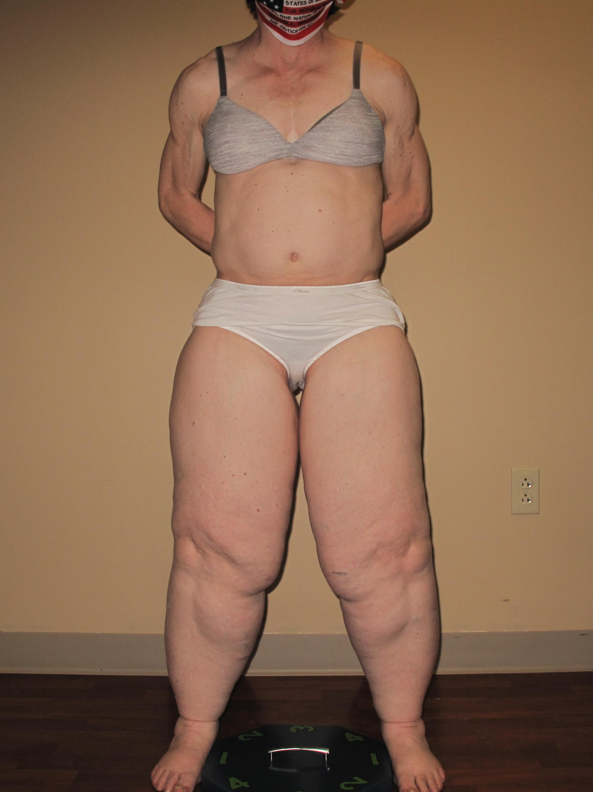
Classic Lipedema

Slide 18

Body Builder

Slide 19
Waist-To-Hip Ratio
What can be used instead of BMI to better assess cardiovascular risk? A few studies show that waist-to-hip ratio (WHR), at least in women, is a better marker for cardiovascular disease risk than BMI.

