Slide 1
Lymphatic Injury After Liposuction
Thomas Wright; MD, FAVLS

Slide 2
Lipedema Reduction Surgery
Lipedema reduction surgery is an modification cosmetic suction lipectomy [liposuction]
Blunt suction cannulas are used
Goal is to complete debulking of all tissues from subcutaneous compartment. Fibrous tissue, adipose tissue and other extracellular components
Longitudinal techniques to avoid lymphatic injury

Slide 3
Lipedema Reduction Surgery & Lymphatics
Impaired lymphatic function has been shown in lipedema
Crescenzi showed increase tissue Na in MRI studies of lipedema. [2018]
Cordero showed impaired lymphatic function on lymphoscintigram in lipedema. [49%] [2018]
Gould and Patel showed impaired lymphatic transport on lymphoscintigraphy. [2020]
Van de Pas also showed impaired lymphatic function in lipedema and in the same patients after liposuction, it showed improved inguinal uptake after liposuction; no significant change in foot clearance. [2020]

Slide 4
Lymphatic Injury after lipedema reduction surgery
Reports of lymphatic injury after cosmetic liposuction are not found.
3 case reports of evidence of lymphatic injury after lipedema reduction surgery.
Is lymphatic injury more likely lipedema patients after lipedema reduction surgery?

Slide 5
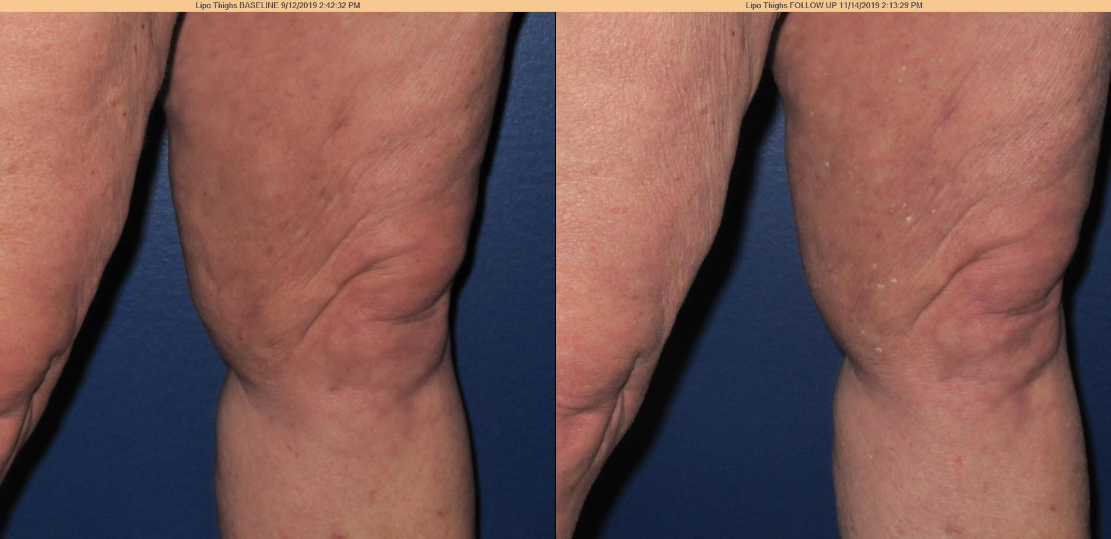
Case 1
A 55 year old woman with stage 2 lipedema and no history of venous or lymphatic disease underwent ultrasound assisted liposuction under general anesthesia and developed dermal fibrosis and dermal papillomatosis in her thighs and persistent swelling of her thighs and calves.

Slide 6
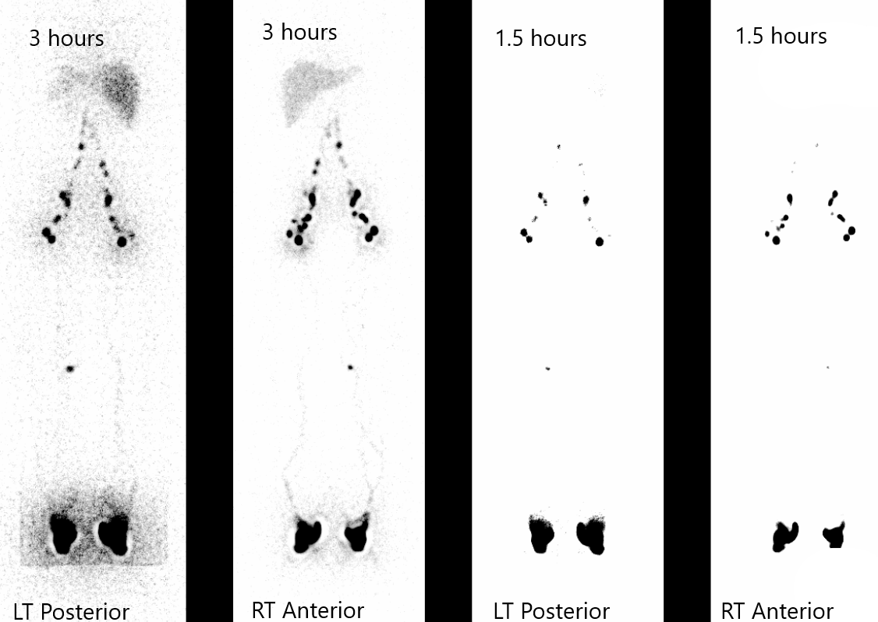
Lymphoscintigrams

Slide 7
Case 2
A 38 year old woman Stage 2 Type 2 lipedema had lipedema thigh reduction surgery. Over a 6 month post-op period, she developed progressive right foot and ankle swelling.

Slide 8
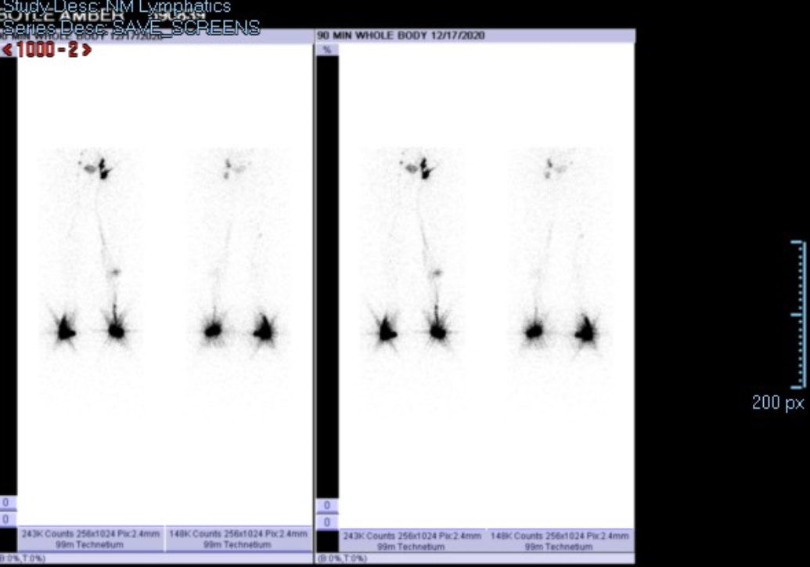
Lymphoscintigram at 90 min

Slide 9
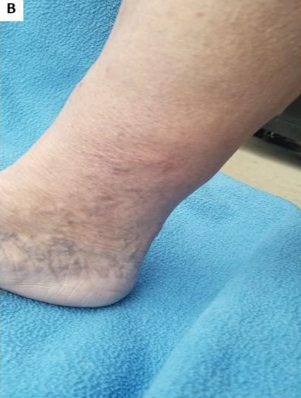
Case 3
A 62 year old woman with stage 2 lipedema and no history of venous or lymphatic disease underwent water assisted liposuction under general anesthesia and developed dermal sclerosis, hyperkeratosis and hyperpigmentation of her left ankle.
After Surgery

Slide 10
Lipedema and Anorexia
The skin changes of dermal papillomatosis, fibrosis, hyperpigmentation, and sclerosis are consistent with ISL stage 2 or stage 3 lymphedema
The timing of the changes were delayed 6 months to 1 year post-surgery and not likely acute arterial/venous injury
These changes likely represent lymphatic injury after liposuction in patients with lipedema
Thank You!

